Slide 1
Comprehensive Seo Audit & Optimization For Organic Traffic Growth - JustBilling
KARTHIGA ELANGOVAN |BADM-WD- MBE 12

Slide 2
COMPANY SELECTION - JustBilling
I selected the company “JustBilling(‘Just Billing- Best Android, Windows, iOS POS Billing Software”) for this SEO project.
About JustBilling :
Leading provider of billing, invoicing, and business management software.
Offers easy-to-use, cloud-based solutions for retail, restaurants, and service businesses.
Supports features like inventory management, POS, customer loyalty, and GST compliance.
Enables businesses to track sales, manage expenses, and generate reports in real-time.
Provides mobile and desktop applications for seamless operations across devices.
Aimed at helping small to medium businesses streamline operations and improve profitability.

Slide 3

PRODUCTS AND SOLUTIONS
The Products and Solutions Provided by the company” JustBilling” are as follows:
Products:
Android POS App
Windows POS Software
Solutions
Retail Billing Software
Restaurant Billing Software
POS for Services

Slide 4
Task 1 - Initial Audit
Current Performance:
The response time is under 0.2 seconds.
All Javascript files appear to be minified.
Strengths:
The SEO title is set and is 61 characters long.
One or more keywords were found in the title and description of the page.
The page is using the canonical link tag.
Both the www and non-www versions of the URL are redirected to the same site.
The site is using a secure transfer protocol (https).

Slide 5
Weakness:
The size of the HTML document is 85 Kb. This is over our recommendation of 50 Kb.
Some CSS files don't seem to be minified.
Some images on the page have no alt attribute.
The meta description is 162 characters long, which is too long.

Slide 6
Task 2 – Keyword Research
Targeted Keywords
Primary Keywords: POS Software, Billing Software, Android POS System, Windows POS Software, Retail POS, JustBilling.
Secondary Keywords: Restaurant POS System, Billing and Invoicing Software, Retail POS System, GST Compliant Billing Software, Small Business POS System.
Long Tail Keywords: Best POS Software for Small Retail Businesses, Restaurant Billing Software with GST Compliance, Affordable POS System for Service-Based Businesses, Windows-Compatible POS Software for Restaurants, Multi-Platform Billing and Invoicing Solution for SMBs
Competitor Keywords: Best POS Software for Retail, Cloud-Based POS System, GST Billing Software, Restaurant POS System

Slide 7
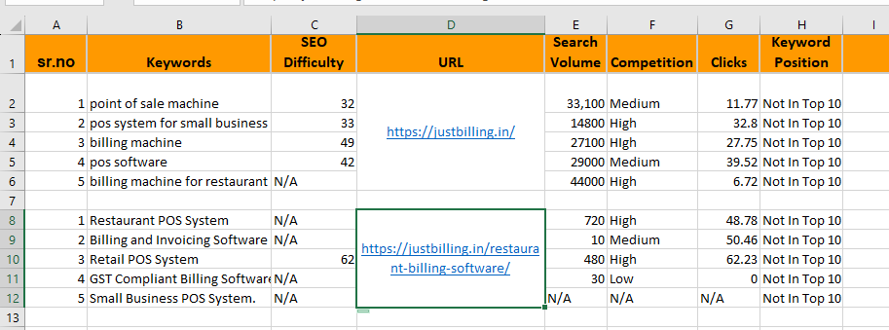
Keyword Analysis

Slide 8
Task 3 - On-Page SEO Optimization Audit
Page 1 : Just Billing- Best Android, Windows, iOS POS Billing Software
This page has a good level of textual content, which will assist in it's ranking potential. Word Count: 1408
This website has SSL enabled.
Title Tag: This website have a title tag, but ideally it should be shortened to between 50 and 60 characters (including spaces). Current Length : 61
Meta Description: Meta description should ideally be between 120 and 160 characters (including spaces). Current Length - 170
Headings: Using relevant keywords or proper hierarchy (H1, H2, etc.).
Content: In this page, main keywords are distributed well across the important HTML tags.
Images: Images on this page are missing Alt attributes.

Slide 9
Page 2 : Bill Fast with Just Billing Android Mobile Billing Application
Both www and non-www versions of your URL are redirected to the same site.
Opengraph meta tags have been found.
Title Tag: The title of this page has 62 characters which is good.
Meta Description: One or more common keywords were found in the title and description of this page.
Headings: One or more H2 tags were found on this page.
Content: In this page, main keywords are distributed well across the important HTML tags.
Images: All images on this page have alt attributes.

Slide 10
Page 3 : Supermarket POS Retail Solution Just Billing made checkouts easy
This Page contains robots.txt file.
Title Tag: The title of this page has 64 characters which is good.
Meta Description: Meta description was found and it is 159 characters long.
Headings: One H1 and one or more H2 tags were found on this page.
Content: One or more common keywords were found in the title and description of this page.
Images: This page has no alt attributes.

Slide 11
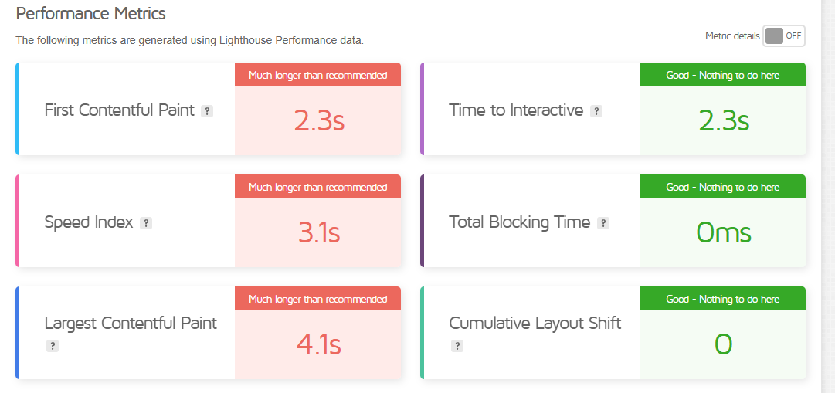
Task 4 – Technical SEO
Page 1 : Just Billing- Best Android, Windows, iOS POS Billing Software
Reduce initial server response time, Serve static assets with an efficient cache policy, Eliminate render-blocking resources.

Slide 12
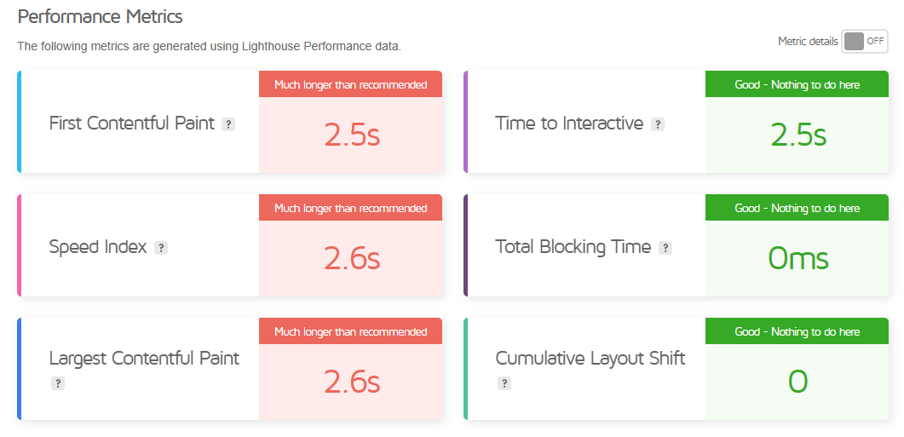
Page 2 – Just Billing- Best Android, Windows, iOS POS Billing Software
Avoid an excessive DOM size, Use a Content Delivery Network (CDN)

Slide 13
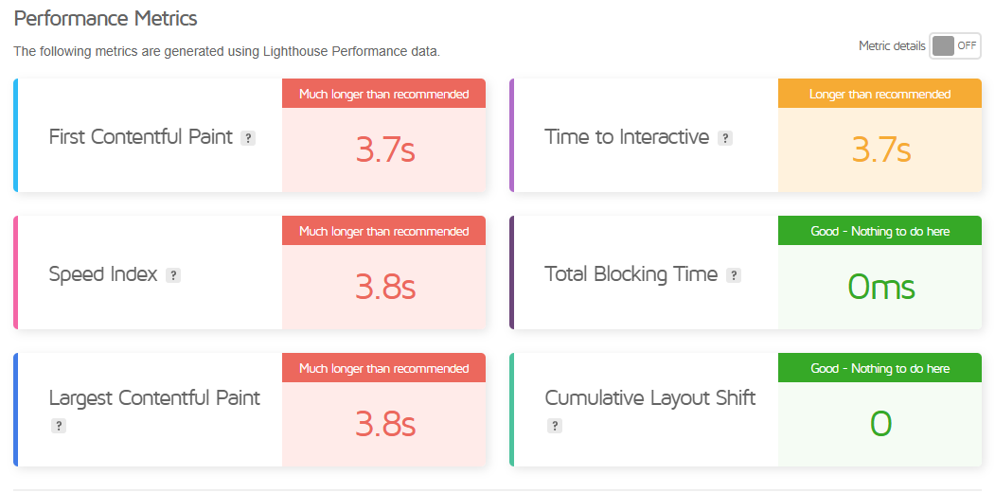
Page 3 : Supermarket POS Retail Solution Just Billing made checkouts easy
Reduce initial server response time , Eliminate render-blocking resources

Slide 14
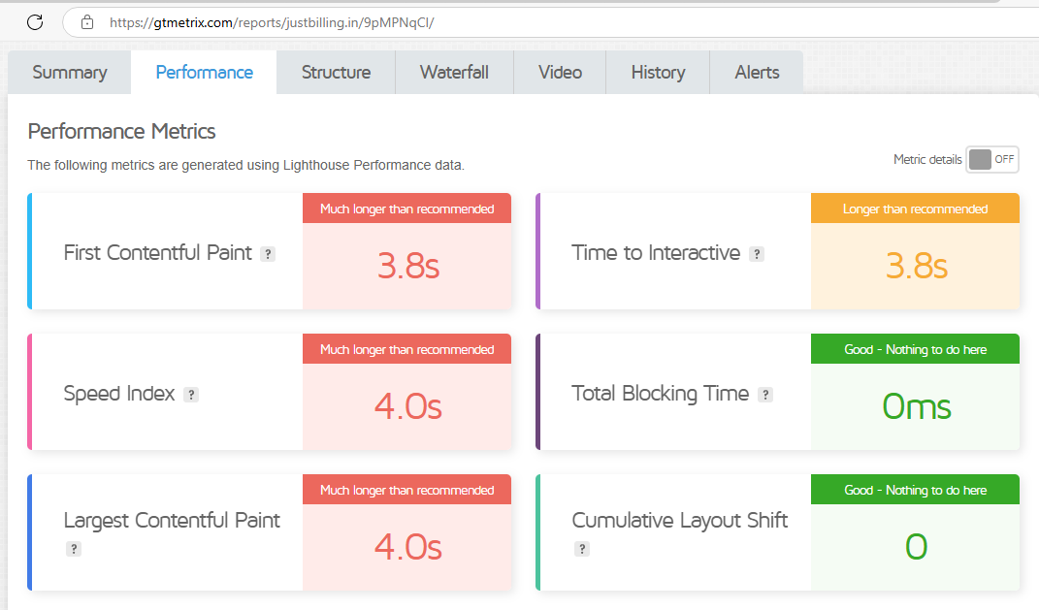
Page 4 - #1 Restaurants & QSR POS software - JustBilling POS System
Use explicit width and height on im.ge elements, Reduce initial server response time

Slide 15
Best Practices to Improve Site and Web Page Speed
Optimize and Compress Images: Use formats like WebP; compress with tools (e.g., TinyPNG) for smaller file sizes.
Leverage Browser Caching: Store static files in the browser for faster load times on return visits.
Minify CSS, JavaScript, and HTML: Remove unnecessary characters and spaces for faster, more efficient code.
Use a Content Delivery Network (CDN): Distribute content globally with CDNs like Cloudflare or Amazon CloudFront.
Prioritize Critical CSS and Defer JavaScript: Load essential CSS first; defer non-essential JavaScript for quicker initial load.

Slide 16
Task 5 – Content Strategy
Blog Topics
Why JustBilling Is the Affordable POS Solution for Retailers.
Why Small Businesses Need POS Software Today.
Choosing the Right POS Software for Your Retail Store.
Top 5 Reasons to Choose JustBilling for Your Restaurant’s POS System.
JustBilling’s Guide to GST-Compliant Billing for Small Businesses.

Slide 17
Task 6 – Off Page SEO
Search Engine Submission - Free Web Submission | Your Submission Results (free-web-submission.co.uk)
Directory – Medium - https://medium.com/@karthigaelangovan09/why-small-businesses-need-pos-software-today-a7bc8193399c
Social media Marketing – Facebook
Online Platfrom - (4) Janani Annamalai's answer to What is the best POS software for retail businesses? – Quora
Letsdiskuss - Karthiga Elangovan- Letsdiskuss

Slide 18
THANK YOU

